Slide 1
Identifying Pests

Slide 2
Cockroaches

Slide 3
Cockroach feces

Slide 4
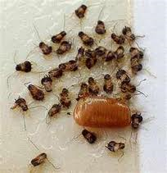
Cockroach egg cases

Slide 5
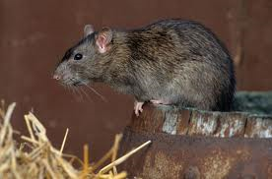
Rodents
Rat
Mouse

Slide 6
Mouse tracks

Slide 7
Rodent feces / droppings

Slide 8
Rodents gnawing

Slide 9
Mouse nest

Slide 10
Rat hole

